Slide 1




EELU ACADEMYA
The Egyption E-Learning University
Qena Center

Slide 2


Supervised By
Prof / Mahmoud Mohamed Hussein
T.A. / Mohamed Fekry
Prepared By
Abdallah Ahmed Safi
Mohamed Alaa el-din Gaber
Sara Mohamed Hamed
Aliaa Mohamed Ahmed
Reem Ali Mohamed
Sanabel Mostafa Mohamed
Reem Mohamed ElHady

Slide 3

Agenda
Introduction
Problem Definition
Objectives
Analysis
Implementation
Future Work
Conclusion

Slide 4


Introduction
EELU Academya is a Site Student Evaluation System adaptable Educational platform that provides a specific course for web development for student who want to be professionals in the web domain.
As we provide all the web tracks in one place to study the web (Front-end, Back-end ).
The site provides paid and free courses. This is the part related to the Instructor, and its playlist will be displayed, and each lesson has its own quiz. After that, the student is allowed to take the certificate, because obtaining the certificate is done under conditions, which are that the student has passed all the quizzes, and there is a chat room between the student and the Instructor, which allows the student to give any question to the Instructor, so that there is no He has any problem.
Functionality of this Application focuses on data storage the courses and shareable information between instructor and his students .

Slide 5


WHY ACADEMYA?
Based on the gap analysis study, we arrived at this through these examples

Slide 6

PROBLEM DEFINITION
The educational process in any e-learning platform is considered a data warehouse.
But Academya provides communication between the student and the instructor.
Which makes the learning process better and more interactive.
Academya also is a dedicated place so students don't have to get More information from other places.

Slide 7



Examples
Some courses are archived, meaning you can still access them but can't earn a certificate
Less interactive. harder to reinforce or test what you've learned
1-EDX
2-Udemy
Less interactive than traditional coding bootcamps
Not as many course options.
only audit one-off courses
3-CodeAcdamey
4- Futurelearn
Less interactive. no way to submit homework assignments.
you can only audit one-off courses (you will have to pay for ones that are part of a Specialization).
“Beginner” level courses may require users to have prior knowledge of the topic.
5-Linkedin learning
Teachers may move through material quickly, which is not suitable for learners who are not familiar with the subject.
6-Coursera

Slide 8


Why use Acadmaye?
Because in our platform we use a large amount of user facilites such as
1- More interactive
2- Can audit one or more courses.
3- Submit homework assignments.
4- A lot of free Courses For EELU students.
5- Have chatrooms and office hours.
6- Can get certification after ending all Assignments and final exams.
7- Enhance the quality of learning and teaching
8- Meet the learning style or needs of students
9- Enhance the quality of learning and teaching
10- Meet the learning style or needs of students

Slide 9

Now we will speak about the website model which mean the plan for the successful operation of a business.
1-
Analysis
By gathering data from studying a number of the same e-learning platform systems we had to know how it works and their advantages and disadvantages we started applying all the user operations and avoiding other platforms' cons to make academya better for our users to deal with it.
2-
Functionally Our system focuses on data storage and sharable information between the instructor and his students.
3-

Slide 10



System Description
First by Requirements
Describe the essential characteristics of the system that will meet Those needs
Functional Requirements
1- Student shall register to see the courses available in the Academya.
2- Student shall take the three adaptable ways of the material to pass the course and get the certification.
3- Student shall take different level of the same course if he did not pass the needed Assessments of the quiz .
4- Student shall answer all the questions in the quiz so that he can see the review of the quiz.
5- Instructor shall follow the tips to start his new course.
6- Instructor shall fill all the information in the form to start publishing for his course.
7- Instructor shall fill all the information in the form to start publishing for his lesson.
8- Instructor shall choose image for his course.
9- Instructor shall fill all his information to be shown in his profile .

Slide 11
System Description
First by Requirements
Describe the essential characteristics of the system that will meet Those needs
Non - Functional Requirements
1- Student shall enroll his name and e-mail so that he can answer the quiz questio
2 - The student shall finish the material course so that the quiz could be opened.
3- Student shall choose from levels(easy-normal-difficult) to start taking the course.
4- Student shall submit his answers in the quiz so that he can see the review of the quiz.
5- The student shall pass the needed Assessments of the quiz so that he can take upcoming material courses.
6- The student shall enroll in the paid courses so that he can join the chat room and take the course.
7- The student shall pass all the needed Assessments after every quiz to get the certification.

Slide 12
System Description
First by Requirements
Describe the essential characteristics of the system that will meet Those needs
Non - Functional Requirements
8- Instructor shall fill all his information to be shown in his profile .
9- The instructor shall register to upload his course and create new chat room for his student.
10- The instructor shall fill out the course information form to stat publishing his new course .
11- Instructor shall fill his information to be shown in his profile .
12- Instructor shall save his informations so it can be shown in his profile .
13- Instructor shall fill the room information form to stat creating his his new room .
14- Student shall enroll to the course so that instructor get notification about his request .

Slide 13
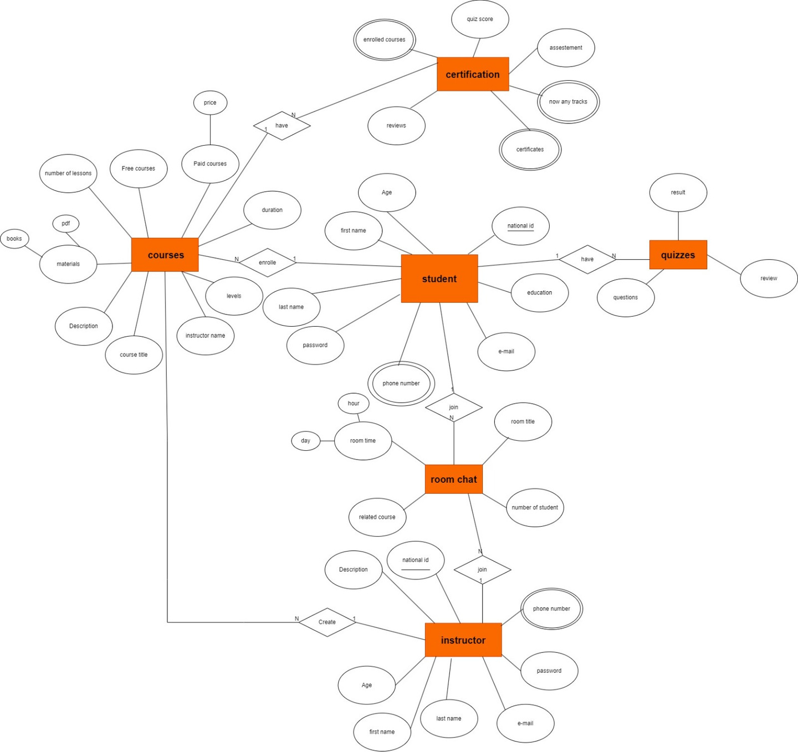

ERD

Slide 14
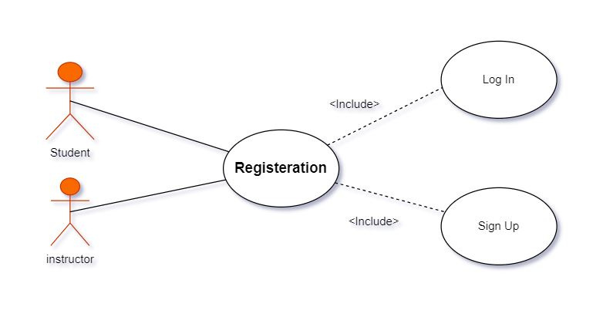

Use Case Diagram

Slide 15
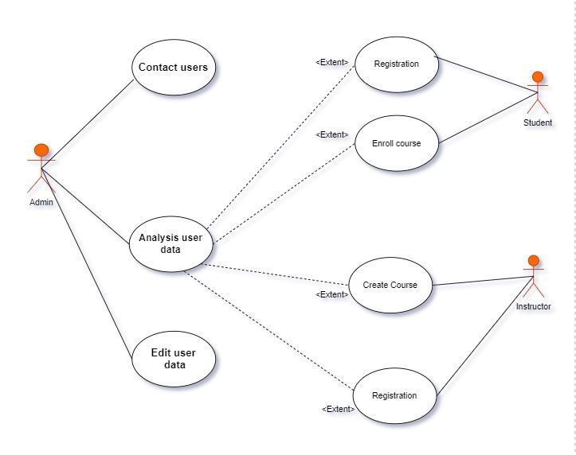
Use Case Diagram

Slide 16
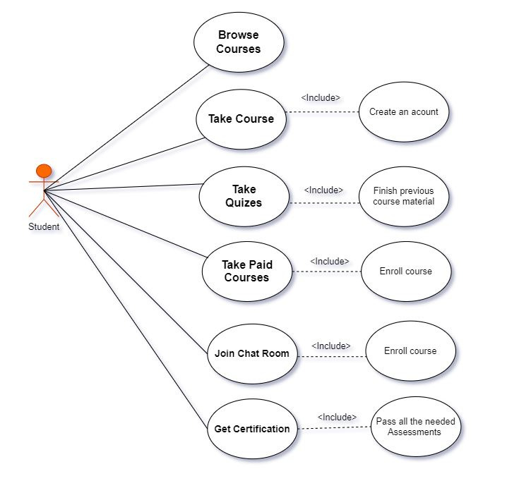

Use Case Diagram

Slide 17
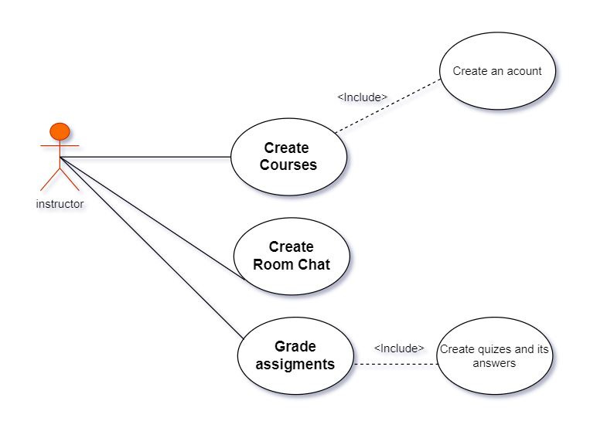
Use Case Diagram

Slide 18

Implementation
We using:
It’s a stage That depends on Coding
We using:
1-apps for building our website xampp local server - Visual Studio Code.
2-using this web technique
MySQL database
3- Using Programming Languages
HTML - CSS - Javascript - PHP

Slide 19
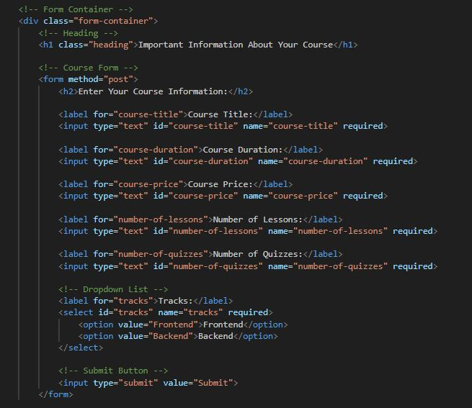
CREATE COURSE

Slide 20
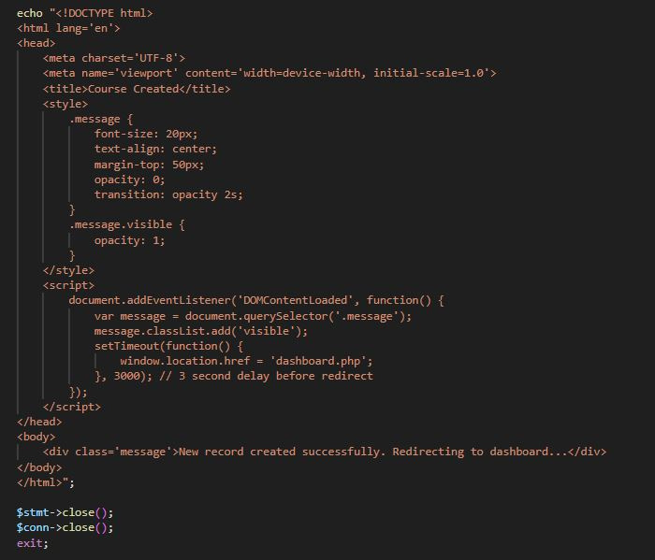

Slide 21
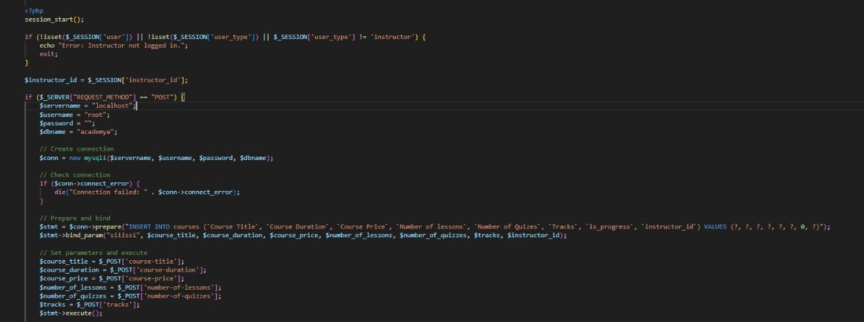
CREATE COURSE

Slide 22
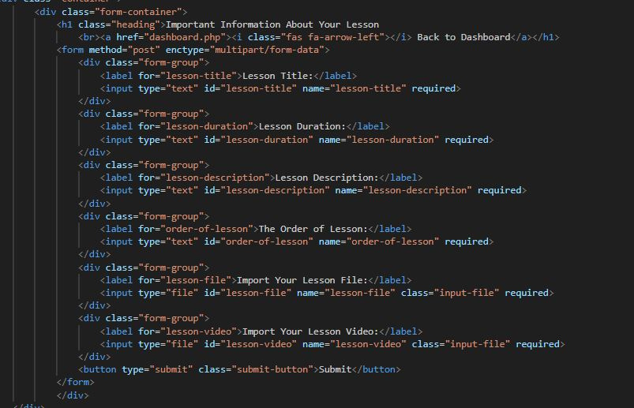
CREATE LESSON

Slide 23
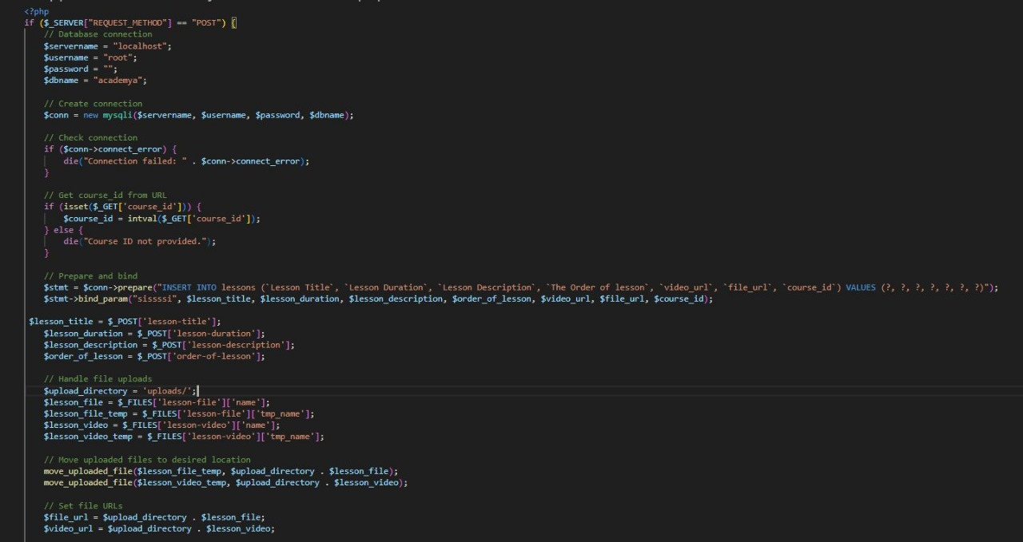
CREATE LESSON

Slide 24
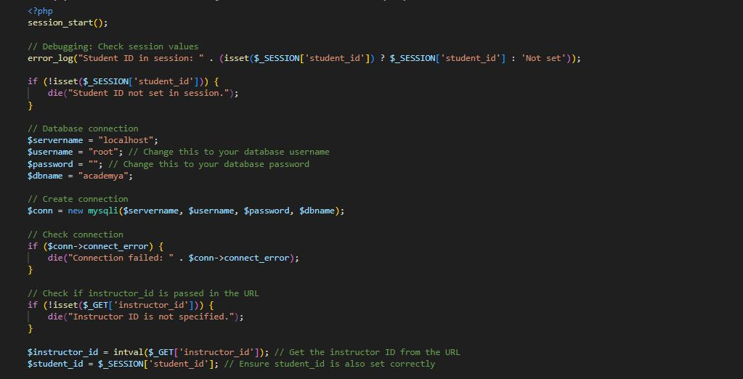
VIEW COURSE

Slide 25
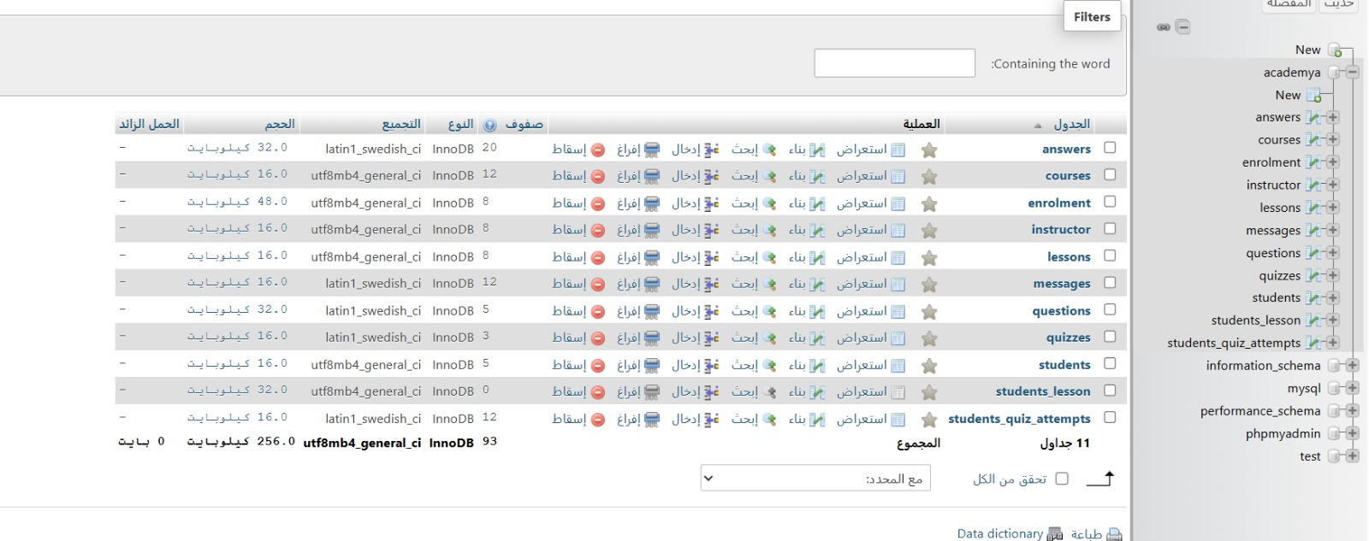
CODING
DATABASE

Slide 26
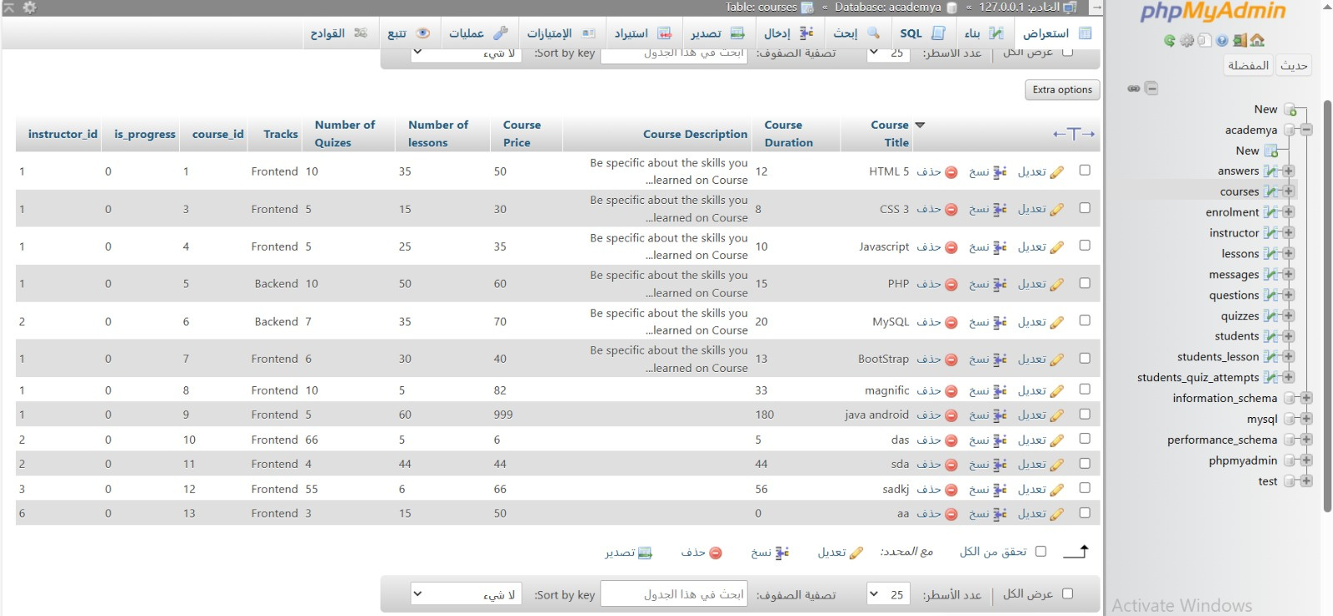
CODING
DATABASE

Slide 27
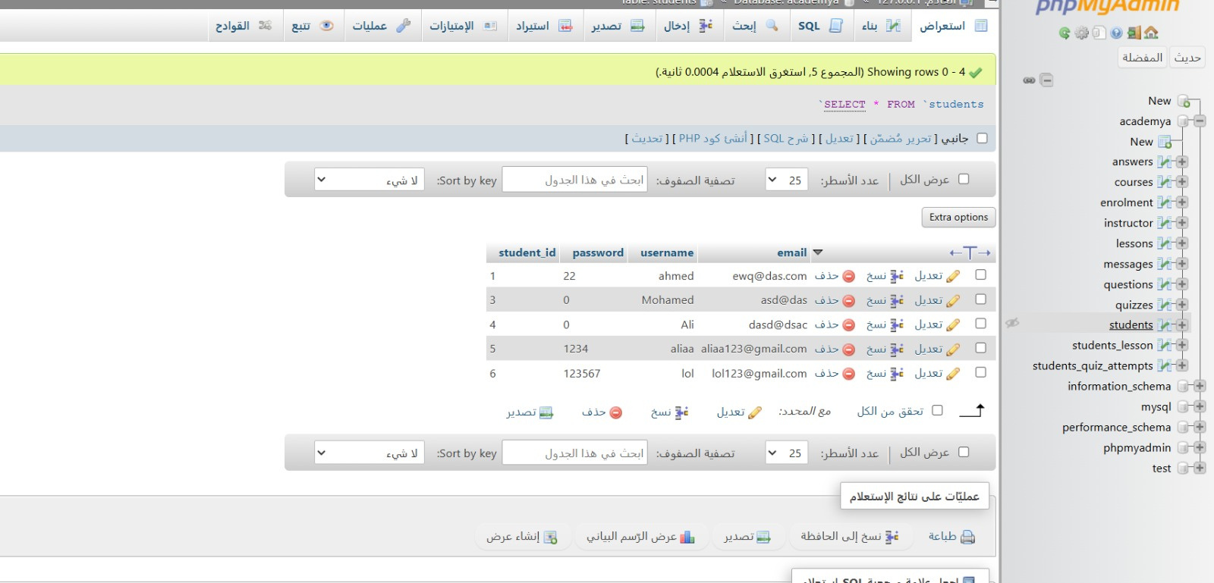
CODING
DATABASE

Slide 28
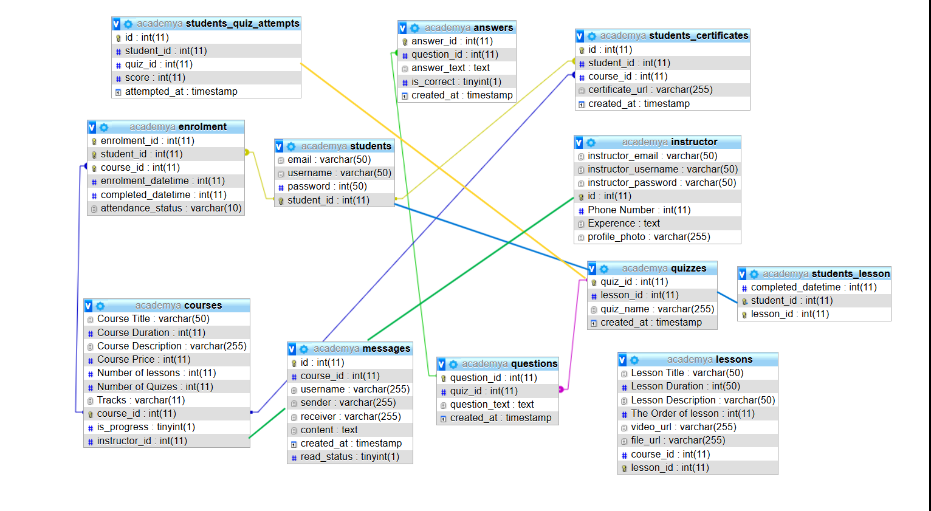
CODING
DATABASE RELATIONS

Slide 29


Future Work
We will add courses and educational paths that are not currently available and covered.
We will create interactive challenges and projects for users.
We will update the course content regularly.
We will ensure that our website is accessible to users with disabilities.
We will organize live programming sessions or webinars with experienced developers.
We will develop a dedicated section for career resources.
We will be implementing a subscription model.
We will consider developing a mobile application.
We will collect feedback from users to improve the user experience and identify areas of improvement in the course content.
We must stay up to date with the latest developments in web technologies to keep our content fresh and relevant. In addition, interacting with your user community and responding to their needs and feedback will contribute to the long-term success of our project.

Slide 30


WEBSITE DEMO

Slide 31
CONCLUSION
In the end, Academya has been concluded, and we hope that you liked it, and thank you for listening.

Slide 32



THANK YOU

